Slide 1
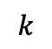
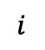


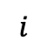

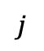

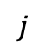
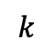
$$j$$
$$j$$
$$i$$
$$i$$
$$=$$
$$k$$
$$k$$
$$=$$
$$+$$
$$…$$

Slide 2


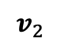
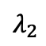

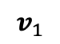
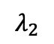
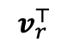
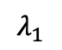
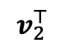
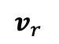
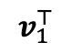
$$λ_{1}$$
$$v_{1}^{⊤}$$
$$λ_{2}$$
$$v_{2}^{⊤}$$
$$v_{1}$$
$$v_{2}$$
$$v_{r}$$
$$…$$
$$…$$
$$…$$
$$λ_{2}$$
$$v_{r}^{⊤}$$

Slide 3



$$A$$
$$C$$
$$B$$

Slide 4
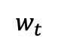
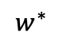
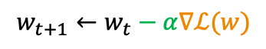
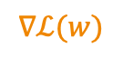
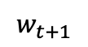
$$w_{t+1}←w_{t}−α∇ℒ(w)$$
$$∇ℒ(w)$$
Loss
Parameter
$$w^{∗}$$
$$w_{t+1}$$
$$w_{t}$$

Slide 5
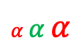
Loss
$α$ $α$ $α$
Parameter
$$w^{∗}$$

Slide 6



$$⋮$$
$$⋮$$
$$⋮$$
Linear Model
Neural Network

Slide 7
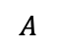
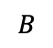
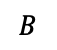
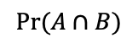
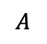
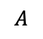
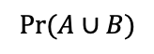
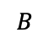
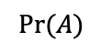
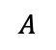
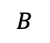
$$A$$
$$B$$
$$A$$
$$B$$
$$Pr⁡(A)$$
$$A$$
$$B$$
$$A$$
$$B$$
$$Pr⁡(A∪B)$$
$$Pr⁡(A∩B)$$

Slide 8
Label 0
Label 1
TPR =
False Positive
True Positive
FPR =
Precision =
True Negative
False Negative

Slide 9
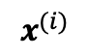
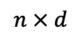

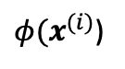
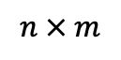
$$x^{(i)}$$
${φ(x}^{(i)}$)
$$⇒$$
$$n × d$$
$$n × m$$

Slide 10
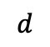
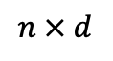
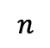
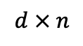
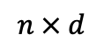
vs.
$$n × d$$
$$d$$
$$n × d$$
$$d × n$$
$$n$$

Slide 11
$$⋮$$
$$⋮$$
$$⋮$$
Linear Model
Neural Network

Slide 12
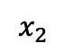
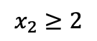
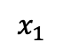
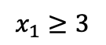


$$x_{1}≥3$$
$$x_{2}$$
$$2$$
$$x_{2}≥2$$
$$3$$
$$x_{1}$$

Slide 13

$$…$$

Slide 14



$$+$$
$$+$$
$$=$$

Slide 15
vs.

Slide 16
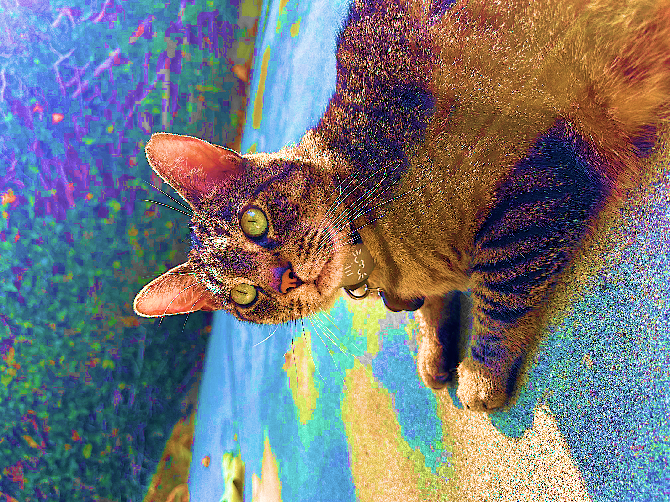
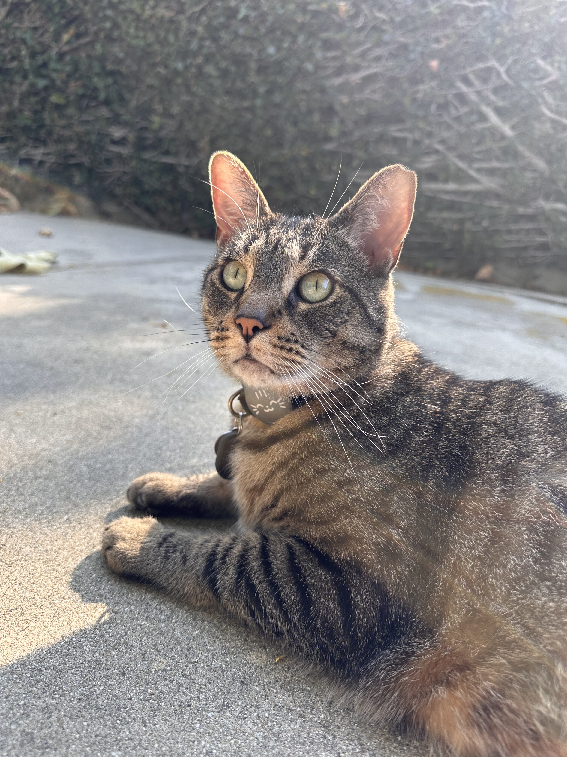
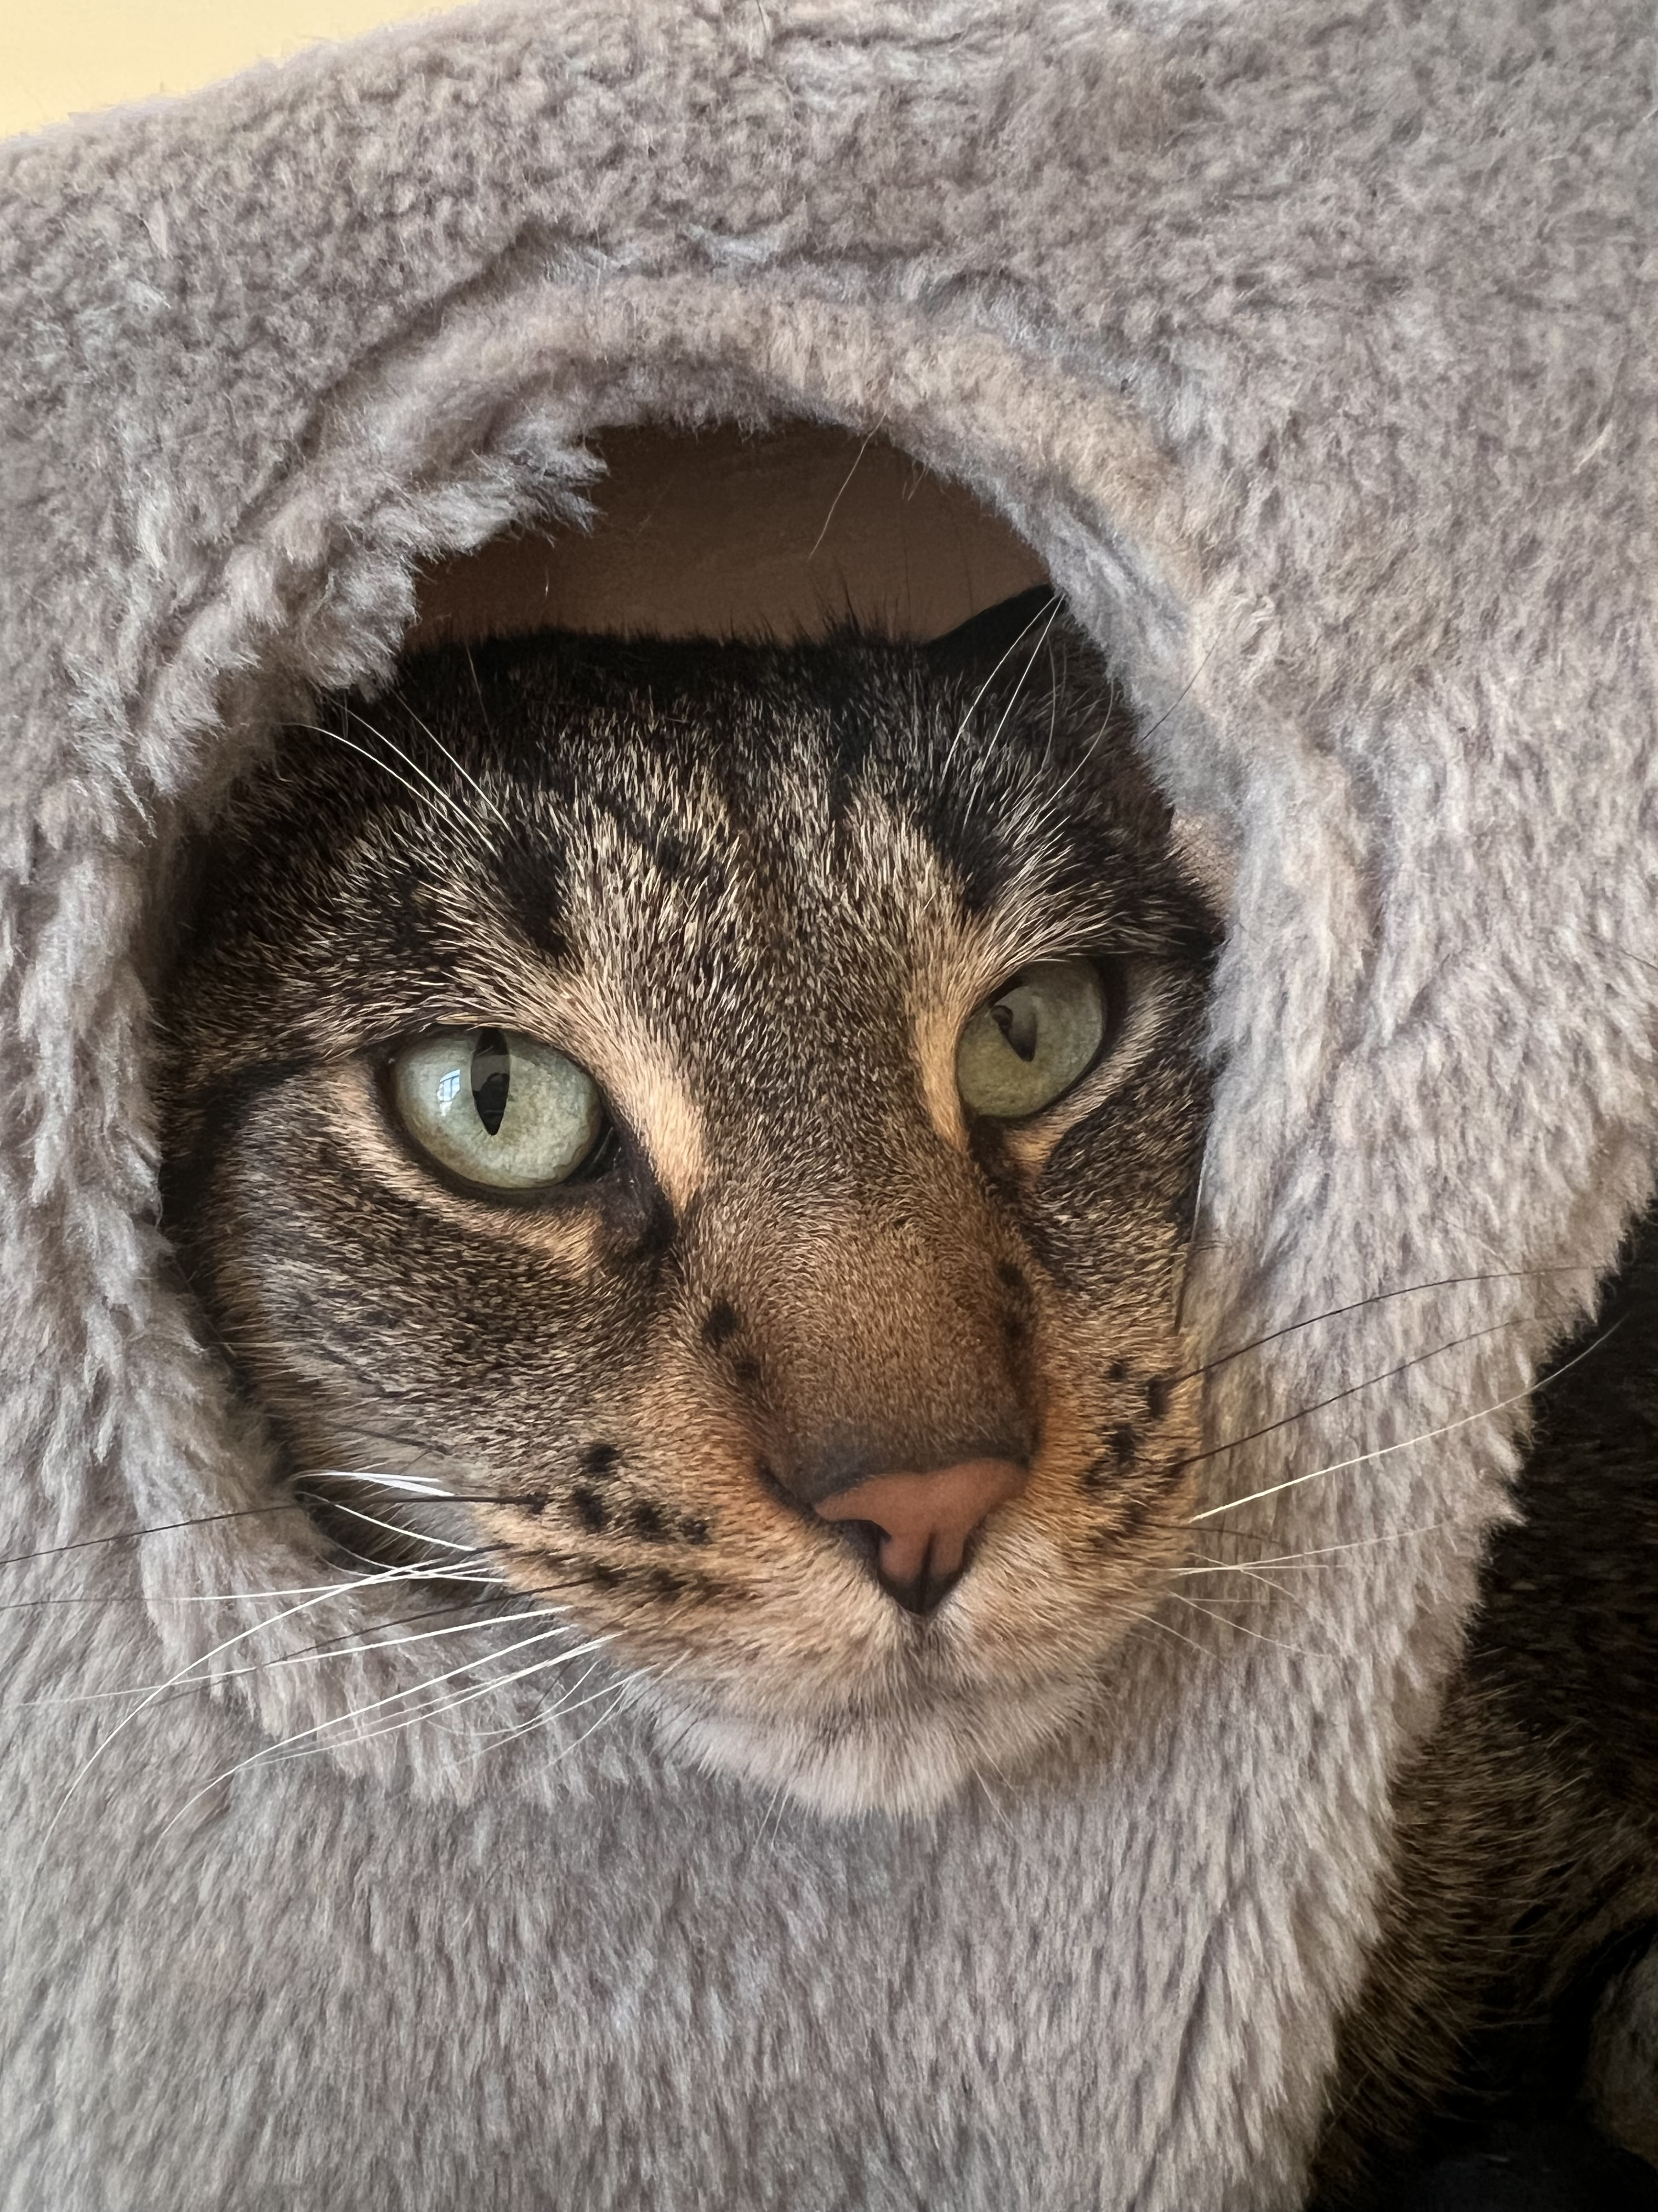
Natural Images
Autoencoder
All Images

Slide 17






$$x$$
$$μ$$
$$\tilde{x}$$
$$z$$
$$Σ$$
$$ε$$

Slide 18






$$x^{⊤}$$
$$W_{0}$$
$$W_{1}$$
$${z=x^{⊤} W}_{0}$$
$$W_{1}$$
$$=$$

Slide 19




$$X$$
$$W_{0}$$
$$W_{1}$$
$$\tilde{X}$$
$$=$$

Slide 20





$$X$$
$$U$$
$$Σ$$
$$V^{⊤}$$
$$=$$

Slide 21
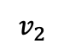
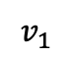


$$v_{1}$$
$$v_{1}$$
$$v_{2}$$
$$v_{2}$$

Slide 22



cat
dog
kitten
puppy
great
good
…
doc₁
 |  | 1 |  |  |  |  |  | 1
1 |  |  |  |  | 1 |  | 1
 | 1 |  |  |  | 1 |  | 1
 |  | 1 |  | 1 |  |  |  |  | 1
 | 1 |  |  |  |  | 1 |  | 1
$$U_{k}Σ_{k}$$
$$V_{k}^{⊤}$$
doc₂
doc₃
$$≈$$

Slide 23


cat
dog
kitten
puppy
great
good
…
doc₁
 |  | 1 |  |  |  |  |  | 1
1 |  |  |  |  | 1 |  | 1
 | 1 |  |  |  | 1 |  | 1
 |  | 1 |  | 1 |  |  |  |  | 1
 | 1 |  |  |  |  | 1 |  | 1
$$U_{k}$$
$${Σ_{k}V}_{k}^{⊤}$$
doc₂
doc₃
$$≈$$

Slide 24
old
dog
dog
young
puppy
puppy
old
young

Slide 25
cat
said
good
trick
“I know some good games we could play,” said the cat.
“I know some new tricks,” said the Cat in the Hat.
“A lot of good tricks. I will show them to you.
Your mother will not mind at all if I do.”
cat
2 | 2 | 0 | 1
2 | 2 | 0 | 1
0 | 0 | 2 | 1
1 | 1 | 1 | 2
said
good
trick

Slide 26
English
Spanish
Japanese
cat
gato
猫

Slide 27
1
2
3
7
1
0 | 0 | 0 | 1
1 | 0 | 0 | 0
1 | 0 | 0 | 0
0 | 0 | 1 | 0
3
1
2
7
3
4
0
7
2
6

Slide 28




1 | 0 | 0 | 0
0 | 1 | 0 | 0
0 | 0 | 1 | 0
0 | 0 | 0 | 1
Stripes on the grass.
Caleb cleaning himself.
Stripes stretching out.
Caleb posing with Lego.

Slide 29






$$E_{1}$$
$$E_{2}$$
$$E_{1}$$
$$E_{2}$$
$$E_{3}$$
$$E_{3}$$

Slide 30


$$\sqrt{Var(X)}$$
$$𝔼[X]$$

Slide 31




$$0$$
$$ε⋅𝔼[X]$$
$$𝔼[X]$$

Slide 32




$$− ε\sqrt{Var(X)}$$
$$+ε\sqrt{Var(X)}$$
$$𝔼[X]$$

Slide 33




$$−ε\frac{b−a}{n}$$
$$+ε\frac{b−a}{n}$$
$$𝔼[\overline{X}]$$

Slide 34
-.53
-.42
+.65
-.07
-.04
-.17
+.15
-.80
-.36
+.93
+.76
+.91
+.84
+.78
+.93
+.87

Slide 35








$$x$$
$$f$$
$$x_{1}$$
$$x_{2}$$
$$f(x)$$
$$⋮$$
$$x_{d}$$

Slide 36



$$φ_{1}$$
$$φ_{2}$$
$$φ_{3}$$
$$φ_{4}$$
$$φ_{5}$$
$$φ_{6}$$
-.5
+3
+1
-2
-1
+2
$$f(b)$$
$$f(x)$$

Slide 37








$$A$$
$$β$$
$$b$$
$$ΠA$$
$$β$$
$$Πb$$
$$≈$$
$$≈$$

Slide 38
vs.

Slide 39
High “leverage” point
Line of best fit
Sampled point
vs.
Line of best fit on samples

